Slide 1
Sprint 1 Presentation
By Buddis
Formerly Known as Piratez

Slide 2
Updates to the BRD & Management Plan
Updated our main goal and premise of our app to be academics related
Changed our target from web app to mobile app
Demographic & Primary Market Research Analyzed
User ease of use and efficiency prioritized
Changed our habits as a team for biweekly sprint team meetings

Slide 3
User platforms
We originally planned this application to be a website but due to our primary market research, we decided to move this to a mobile app
This would be more convenient for students since phones are much more convenient for them to use.
We also do not have to learn a new language to program the application

Slide 4
Main Coding Language
Java
JDBC in use with MySQL
Mobile application development for Android
Any potential server

Slide 5
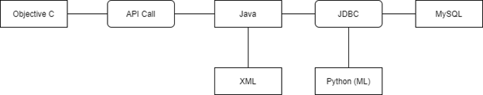
Overall languages

Slide 6
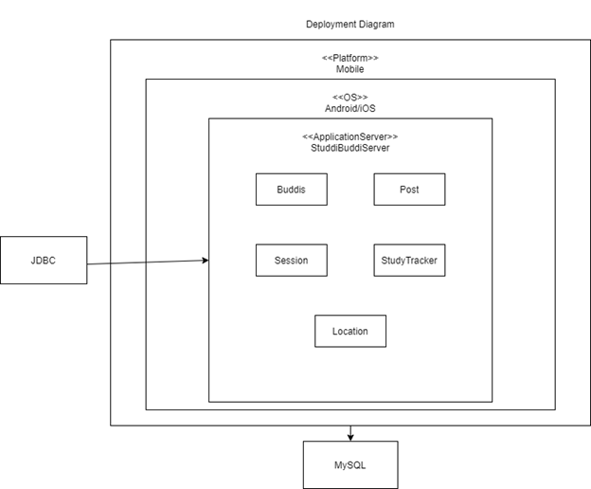
Databases
MySQL
Will use MySQL to store all information needed
Chosen since everyone has experience and we prefer to use JDBC with database tables we create ourselves

Slide 7
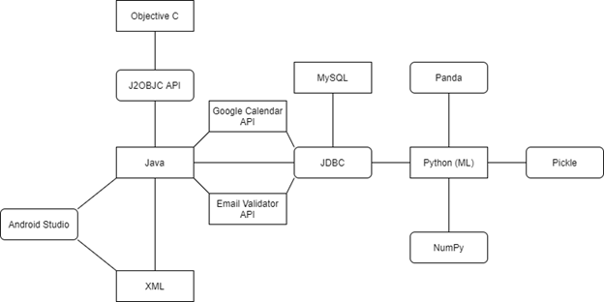
Frameworks/APIs
7 APIs
1 Server (MySQL server)

Slide 8
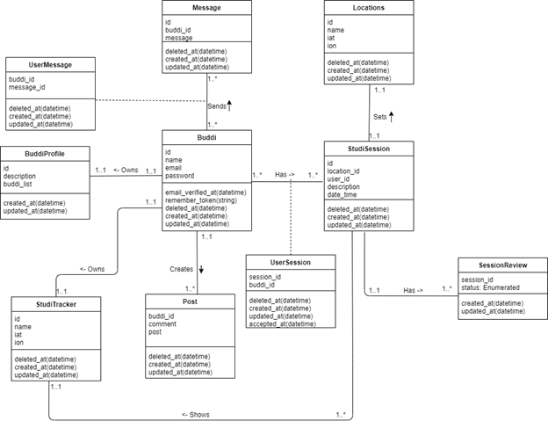
Components/Classes
Classes reflect key objects and their behaviors in our app

Slide 9
Architecture Alternative
Firebase
For easier database implementation
Web application
Would change the architecture of our app in various ways
PHP or Node.js for MySQL
Different languages and frameworks

Slide 10
Product Goals (PRD)
Key goals
Mobile app that allows students to freely and openly share what they need to study for
Connect with students on campus and help each other with material and study habits
Alleviate awkward “first-step” of physical interaction where students ask each other to study outside of class
Develop strong study habits through automatic scheduling capabilities (machine learning)

Slide 11
Key user stories
Most significant: Creating a studdi session
A user can create a studdi session with another user
A user cannot already be in another studdi session with another user
Create post
A user can create a post with the title of the class, subject, and description of what they are struggling with in the class
Accepting a studdi session
A user can accept a studdi session from another user
Allows the user to join a studdi session

Slide 12
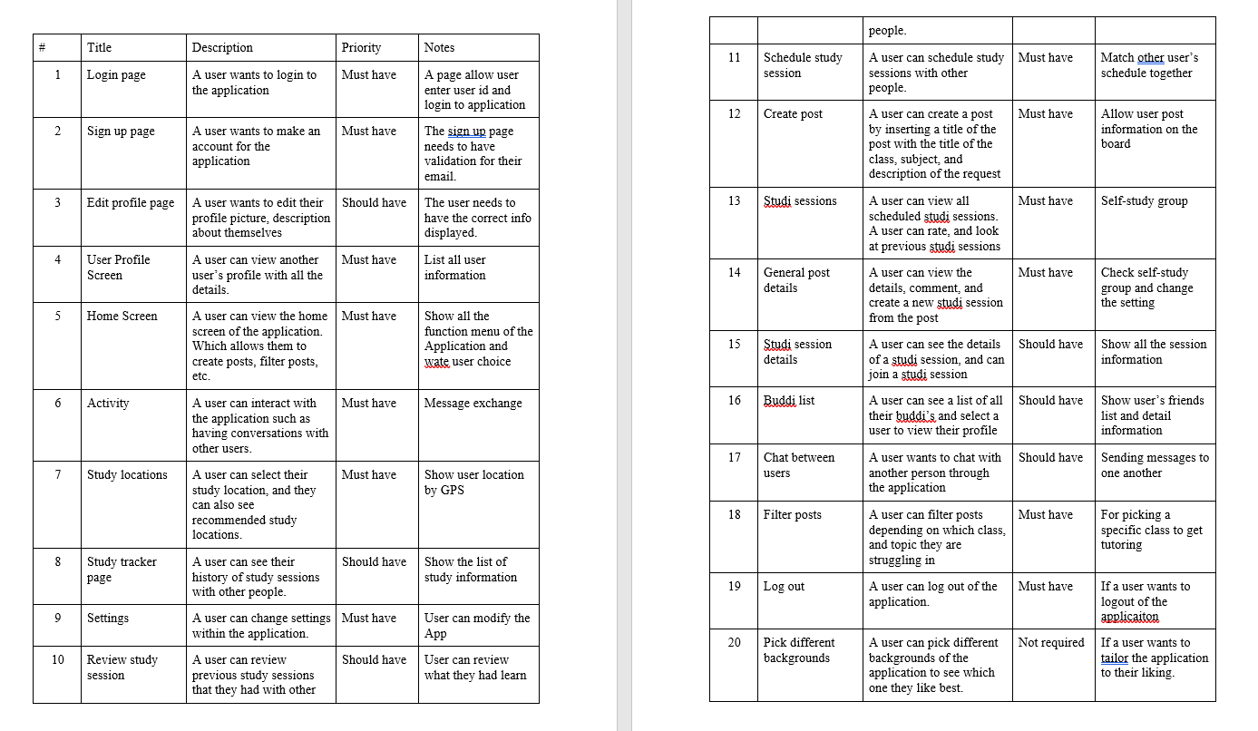
User stories as documented in PRD

Slide 13
In progress user stories
Currently all of the user stories are in progress
We have not had a code release yet
For each user story there should be at least 3-6 tasks

Slide 14
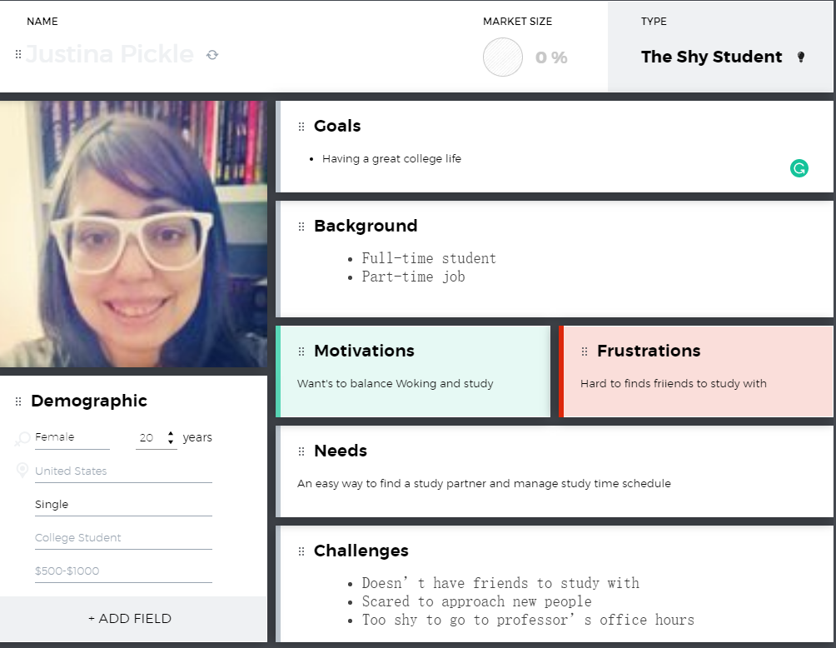
User Personas
The shy student
The new student
The international student

Slide 15
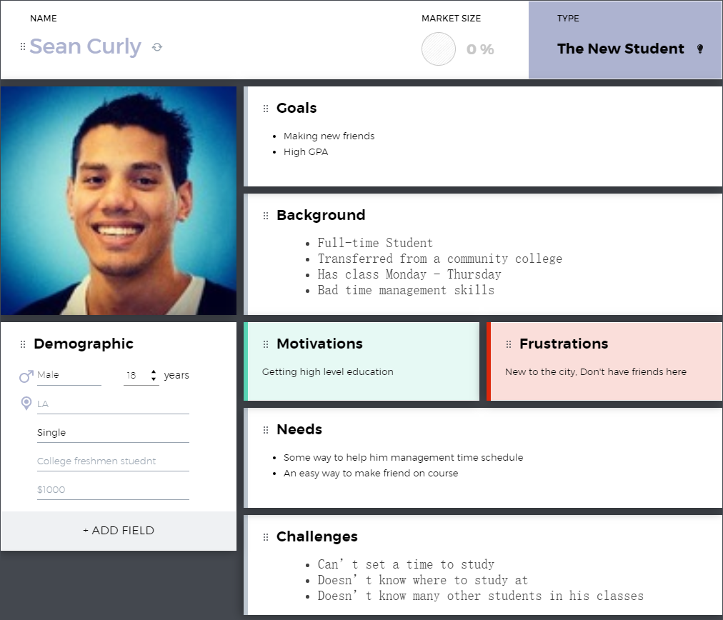
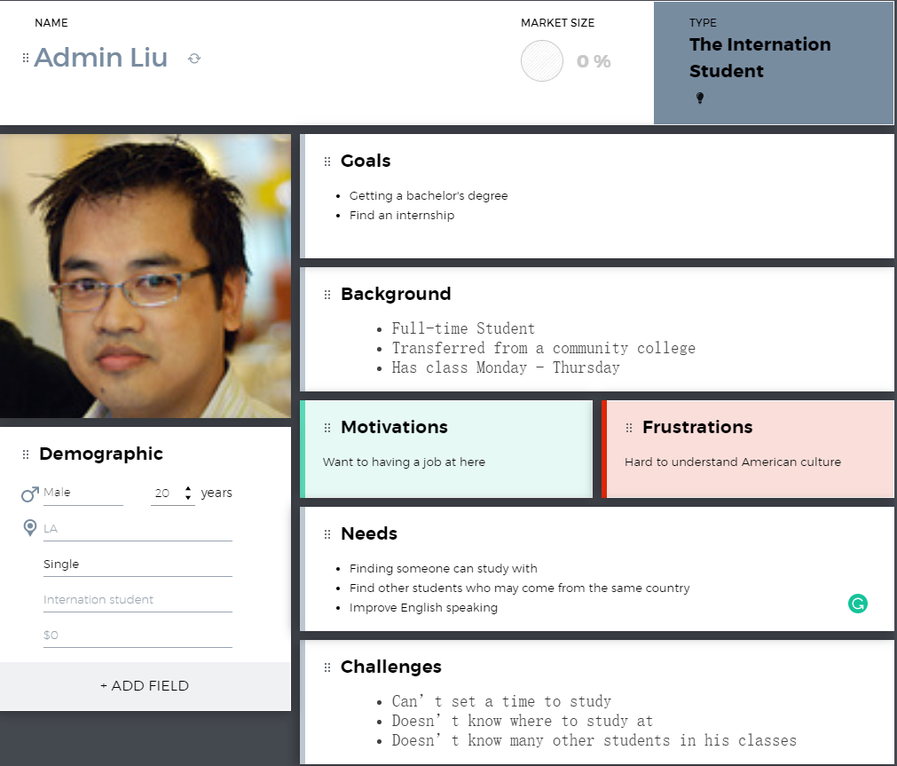
User Personas
Notes:
Mention or add the third persona

Slide 16
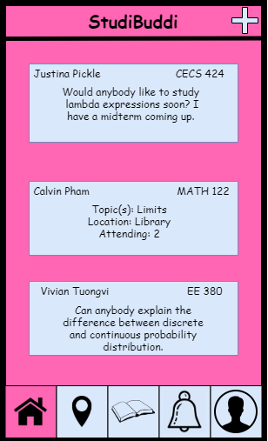
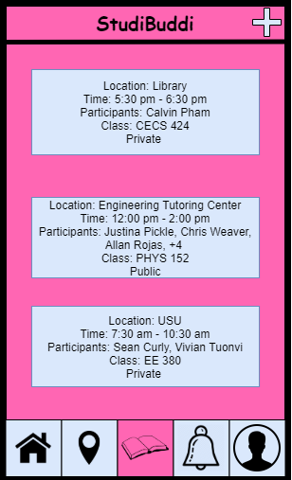
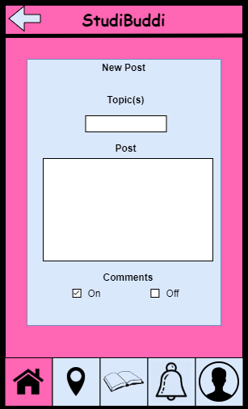
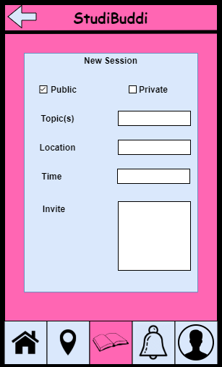
Wireframes

Slide 17
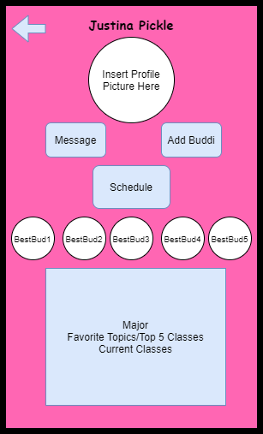
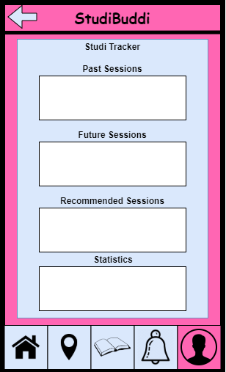
Wireframes

Slide 18
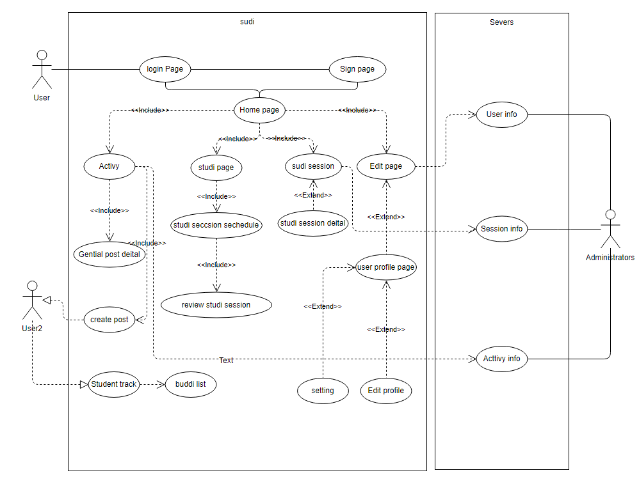
Use case Diagram

Slide 19
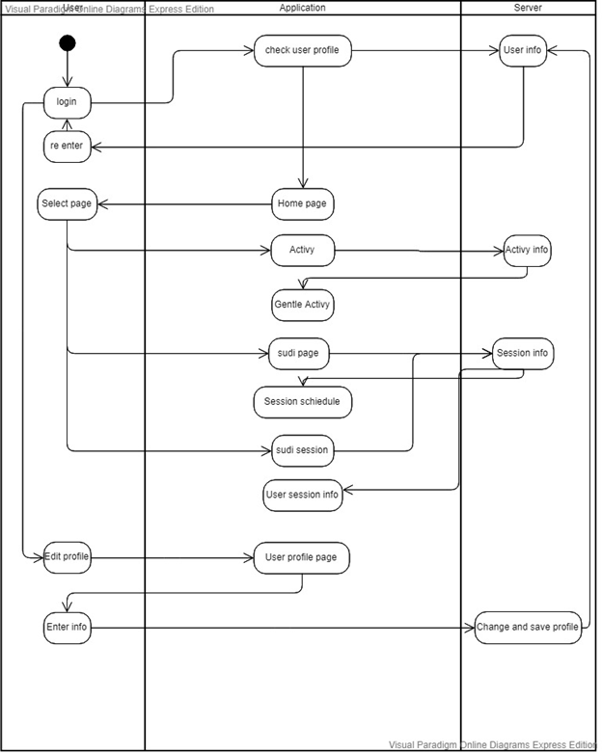
Activity Diagram

Slide 20
Android vs iOS Tradeoff Analysis
Criterion | Weight | Android | Apple
Our Technological Experience | 20 | 15 | 5
Accessibility | 10 | 8 | 7
Audience | 10 | 7 | 8
Timeline | 5 | 3 | 4
Software Features | 20 | 15 | 10
Hardware Features | 25 | 23 | 20
Performance | 10 | 8 | 8
Total | 100 | 79 | 65

Slide 21
Future Iterations
Generality
Available on both Mobile system
Safety
User safety
When user going to meeting someone should know
Data safety
Avoid data breach
Privacy
Even data breach happened, user privacy should be safe
Accessibility
Adding more useful feature in future

Slide 22
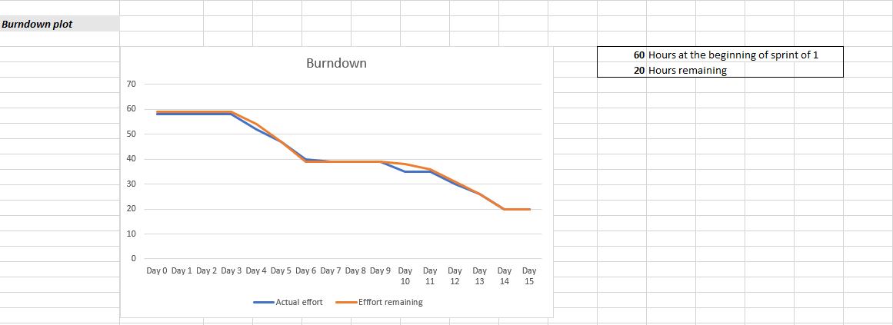
Burndown Chart

Slide 23
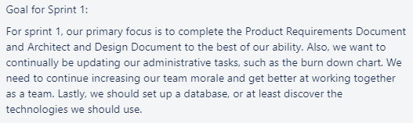
Sprint Goal

Slide 24
Sprint Retrospective (Review)
60 story points planned
40 completed
Tasks planned and completed
Product requirements document
Architecture and design document
Tasks planned and not completed
Business requirements documents
Did not set up database, but began login page
Highest priority stories selection
This sprint, it was decided by what tasks would affect our grade the most

Slide 25
Sprint Retrospective
Great - continue doing
Performed well as a team on PRD, led to a score we were happy with
High team morale
Consistently meeting outside of class
Poor - stop doing
Still not working at a consistent pace, waiting until specific days to do lots of work
Need better task delegation
Start doing
More coding
Notes:
hello

Slide 26
Plan for Next Sprint
Front end - Hunter
Android Development
Back end - Tanner & Oscar
Database Design, APIs
Graphic Design - Hunter and Oscar
Graphic Design of app
Documentation and Planning - Tymee and Luke
Updating our BRD, ADD, etc. as we go on
Language & Framework Learning - Everyone

Slide 27
Planned by end of Sprint 2
Code release - software demo of mobile app
Database design release
Completely redone Business Requirements Document submitted with our new idea
Select a Machine Learning Model for our needs

